Slide 1
Balance XY
Identification and Control of a Classical Underactuated Non-linear System

Slide 2
Motivation
Education
Imponderables
Experiences

Slide 3
Introduction
We are the descendents of the early ape that has evolved for over 2.5 million years from a creature that used 4 limbs for locomotion to a highly dexterous and agile sapien that uses only the two lower limbs for locomotion. Balancing on two legs is something that we take for granted because it is just one of many non-linear behaviours that we emulate everyday.
A complete conception of this non-linear activity - Balance - has empowered us to build a variety of complex systems ranging from Rocket Attitude Correction Systems to PTVs like the Segway .
The science of balance changes from system to system based on its dynamics but the approach to modeling such systems remains consistent across the landscape.
This project aims at designing a system that emulates balance, building over the foundations of an inverted pendulum which is an example of a classical underactuated non-linear system.

Slide 4
Linearization of the Non-linear System - A Traditional and Robust approach
An inverted Pendulum is a non-linear system which has to be linearized before we design a controller using the State Space Model.
Control of Stochastic Non-linear Systems is another design methodology that can be directly employed for control in this scenario, the nuances of which we have not yet understood.
State Space modeling is not an adaptive or modular control strategy as it relies on absolute values of the physical parameters describing the dynamics of the model but is more robust and easy to setup if the design strategy adopted for physical modelling of the system is real-time and simulation based.

Slide 5
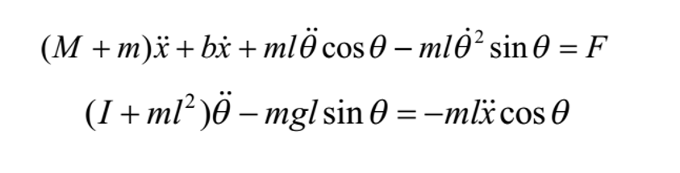
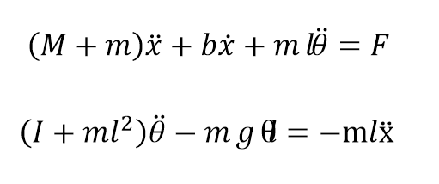
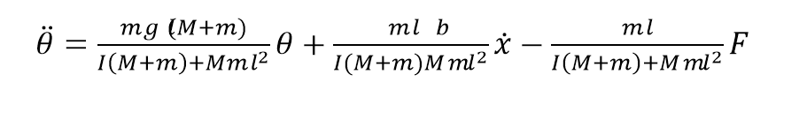
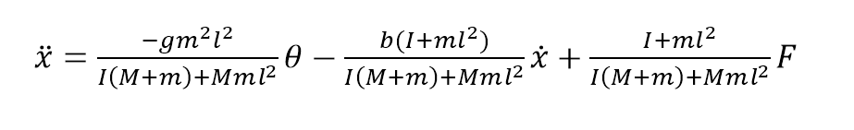
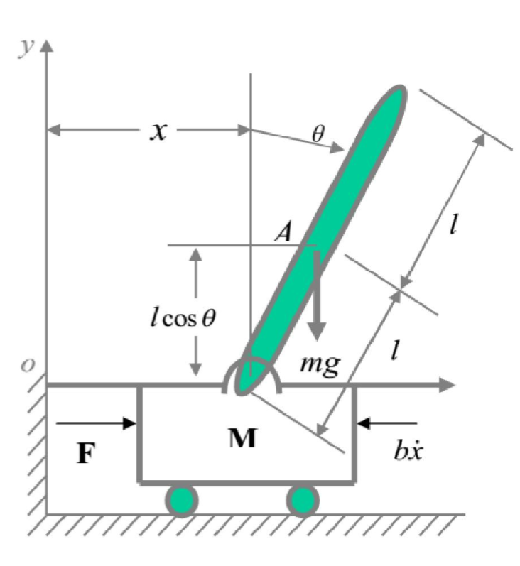
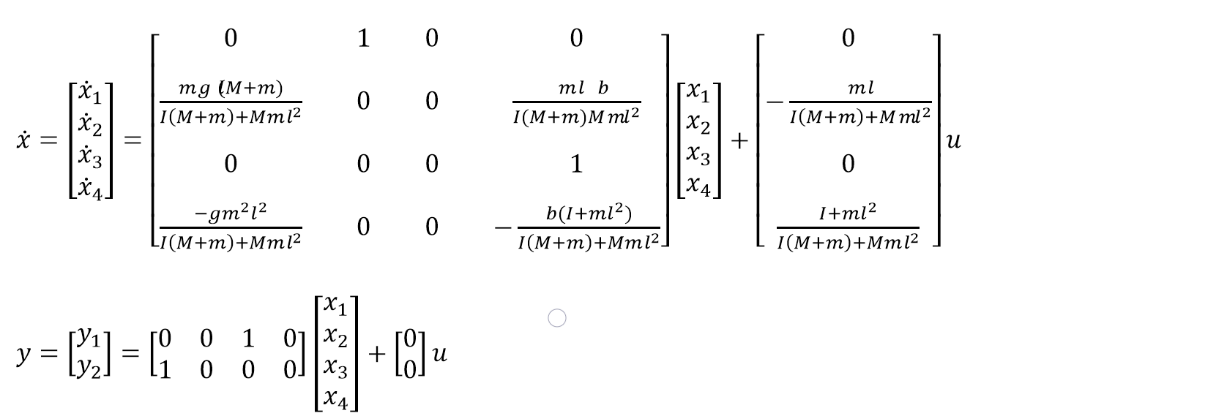
Given below is an example that illustrates the above described problem :

Slide 6
Proposal Overview:
In this Project we propose to build a two wheeled robot control system capable of balancing around its fixed set-point without falling forward or backward. This is achieved using off the shelf electronics and hardware supplies making it the simplest construction for rapid realization of the envisioned design.
As this project starts with the design of the robot’s structure and is equipped with hand soldered electronic circuits featuring unfastened connecting wires and precariously held sub-units, it is difficult to administer a grey-box or white-box modelling strategy. The black-box modelling strategy is not considered as an option for system identification for two specific reasons:
It fails to provide insight into the functioning and the model parameters of the proposed control system
Abstraction concomitantly comes with unstable modularity aiding accuracy and precision

Slide 7
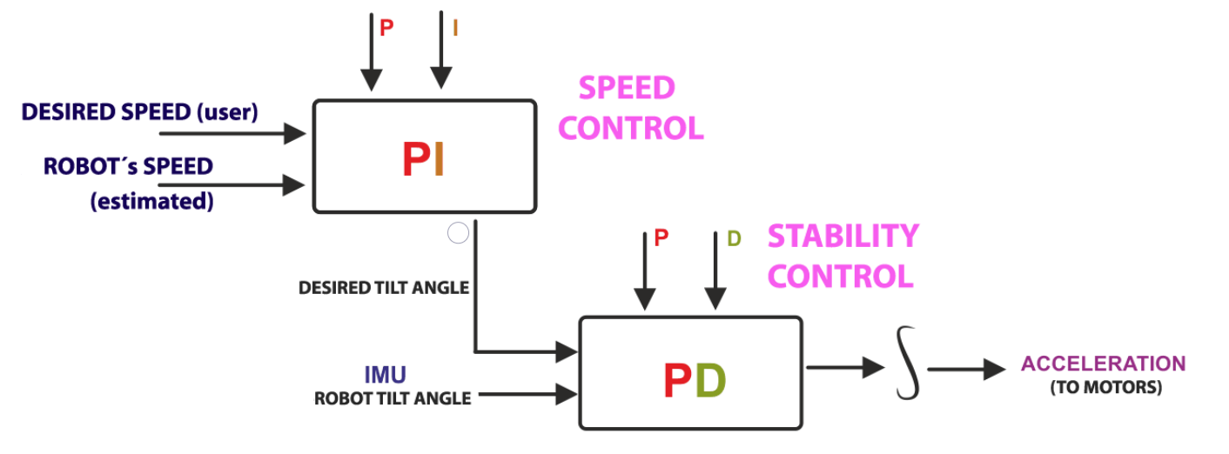
PID Controller Based Multiloop Cascade Control as a simplified ad hoc Control Mechanism
This Control Strategy can be implemented on the system without measuring the physical parameters of the system or a state space model, though their identification would simplify and expedite the process of determination of gains of the proposed robot system.

Slide 8
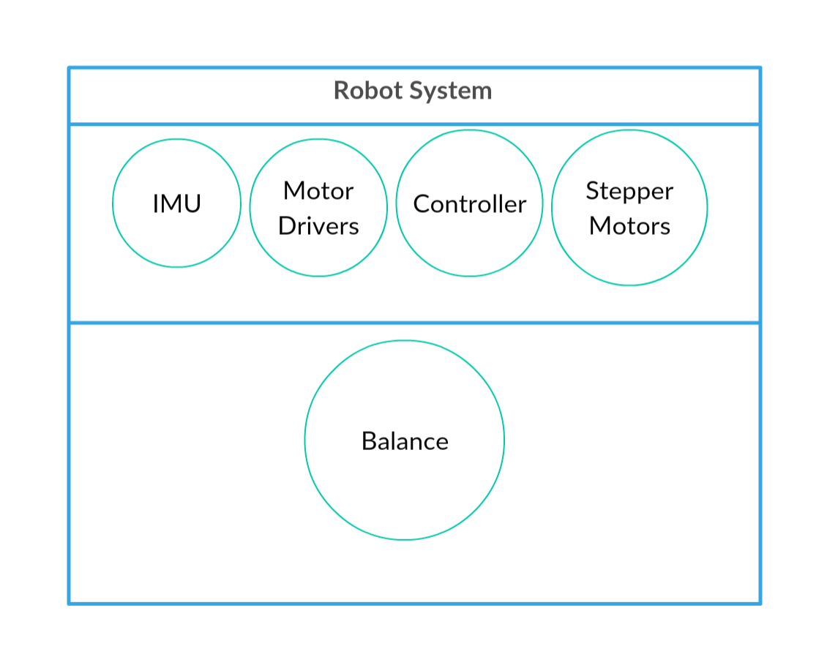
System UML Diagram

Slide 9
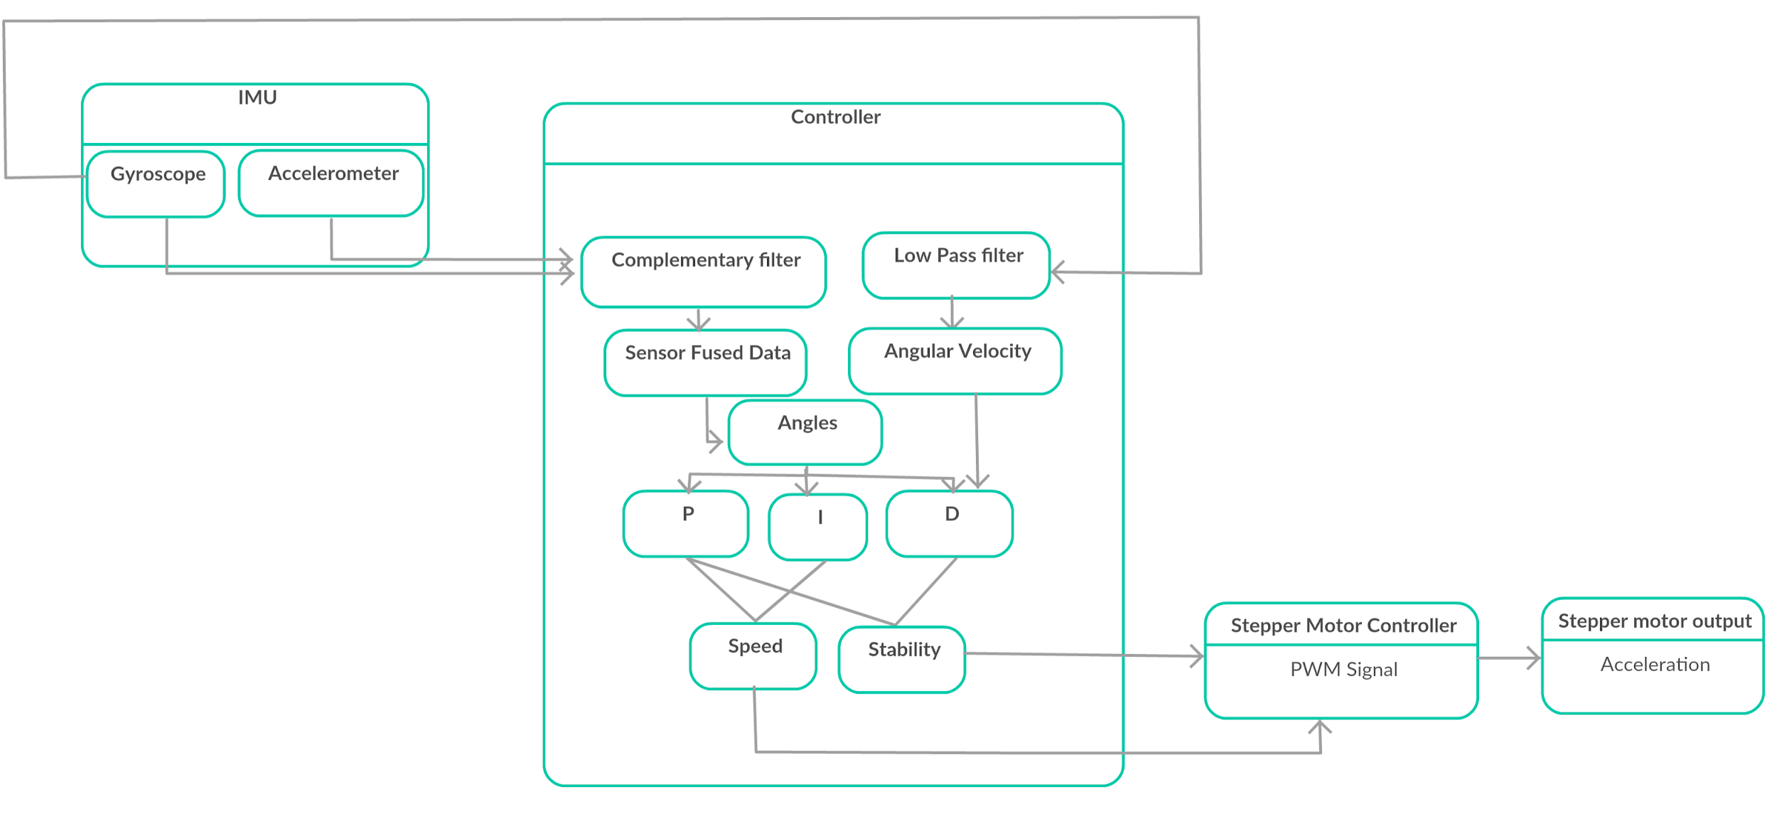
Process Flow Diagram

Slide 10
Physical Modelling of the Robot System

Slide 11
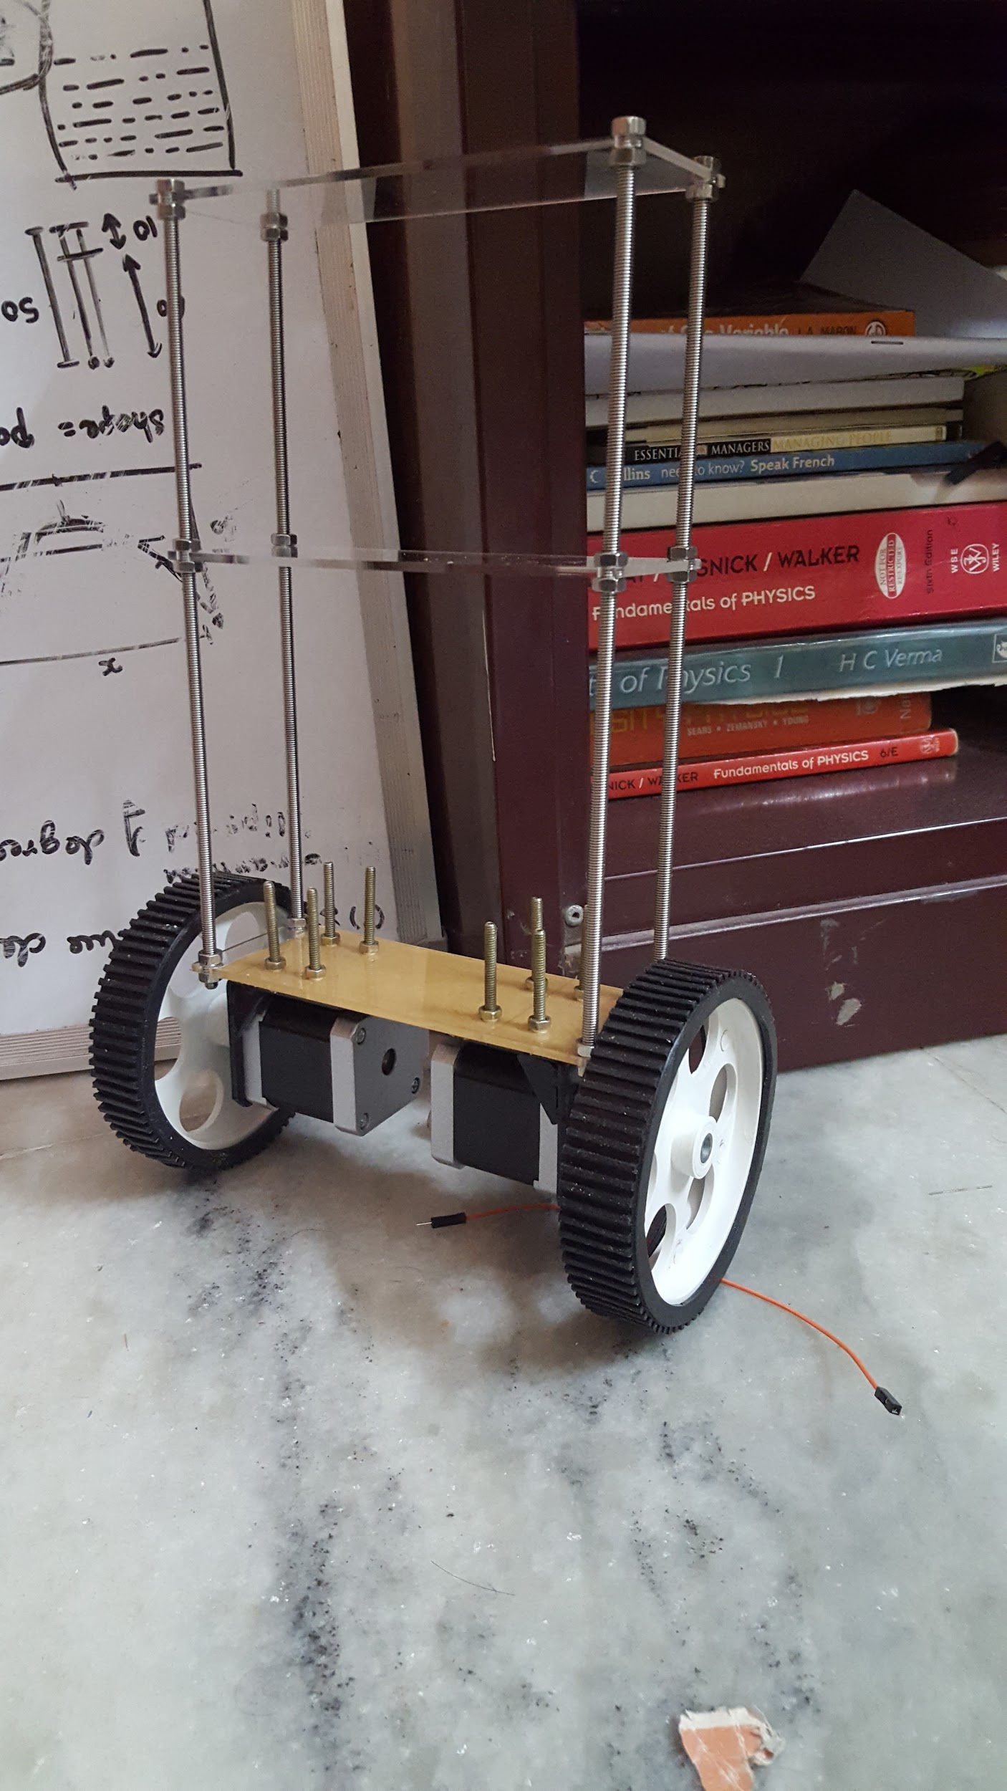
Generation 1

Slide 12
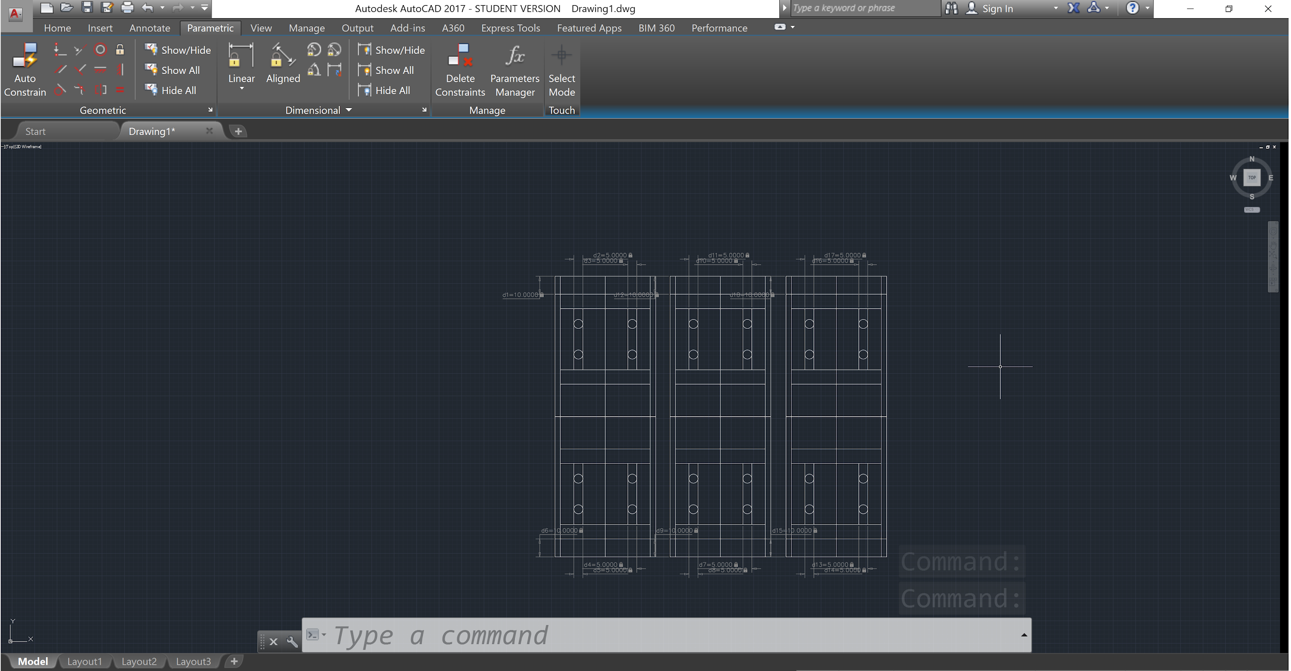
2D CAD Design

Slide 13
Making of the Model

Slide 14
Hardware:
Arduino Leonardo
A4988 Stepper Motor Controllers
NEMA 17 Stepper Motors
IMU - MPU6050
prototyping board
DRPS
Buck converter
PLA based FDM 3D Model

Slide 15
Fabrication of the Hardware

Slide 16
Software of The Robot Control System

Slide 17
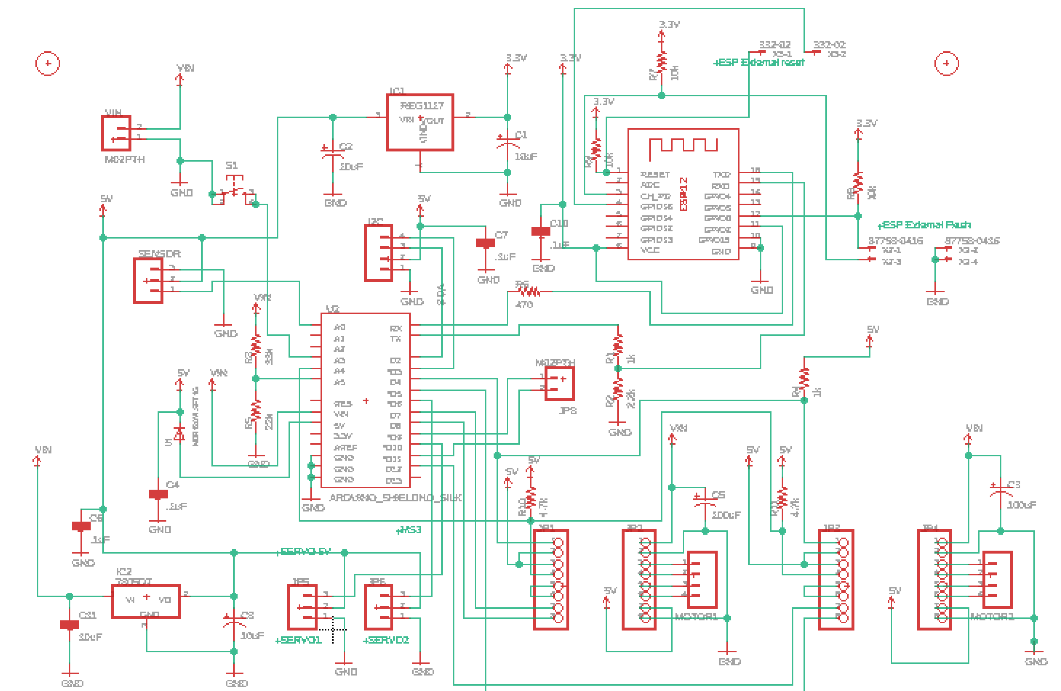
Circuit Schematic

Slide 18
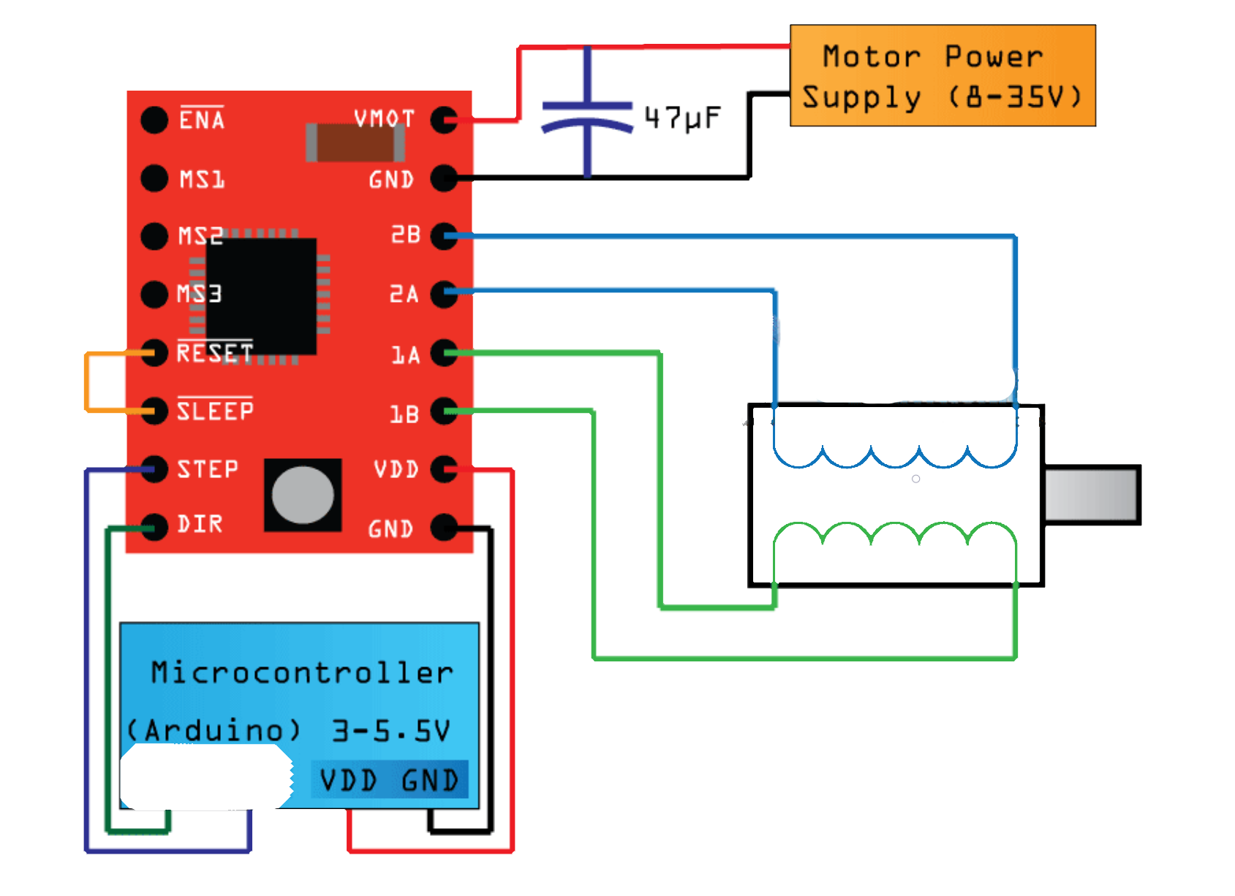
Stepper Motor Connections
Dir Stp

Slide 19
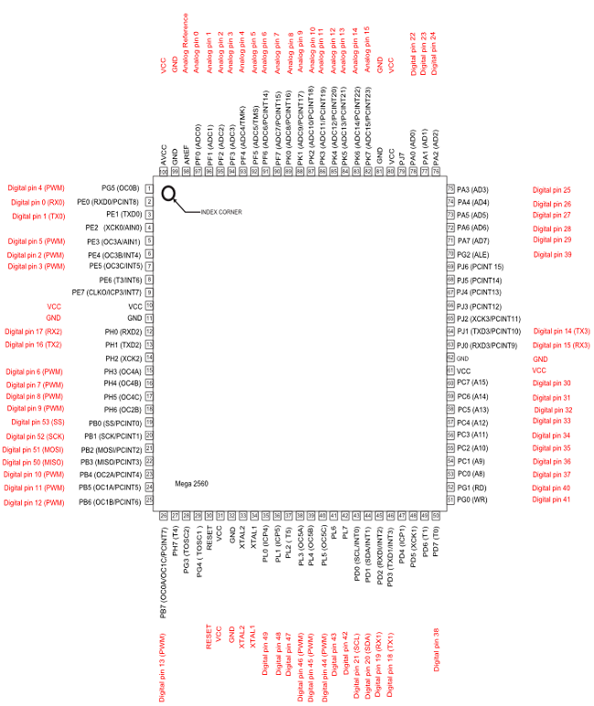
PORT to PIN map for Arduino MEGA 2560

Slide 20
Code for Working of the Motors

Slide 21
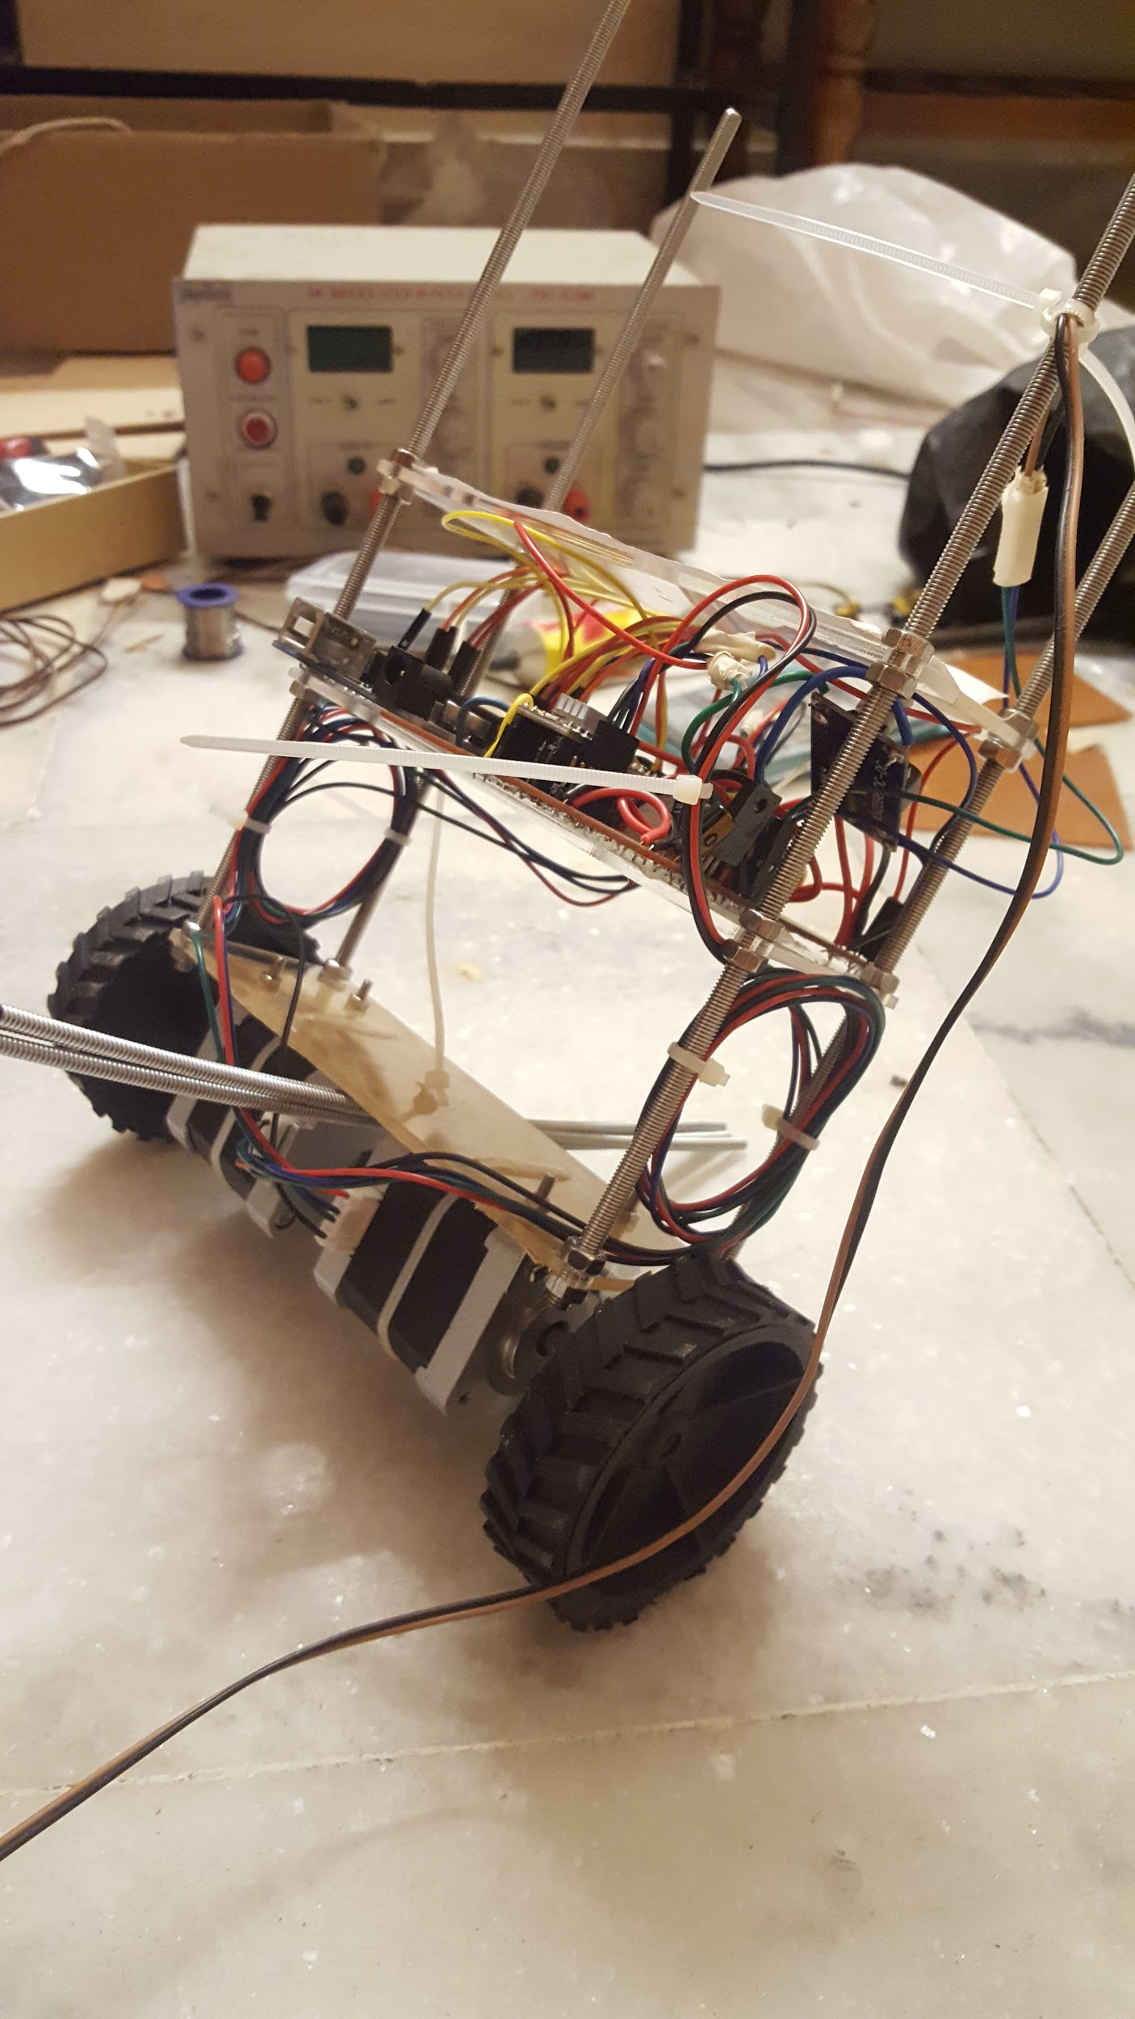
Current Status

Slide 22
Applications in Vogue:
Personal Transport Vehicle - SEGWAY
Rocket Thrust Control
Satellite Attitude Correction
Missile Target Tracking (Inertial)

Slide 23
Envisioned Application
Robotic Butler with Electronic Leash
Efficient Transportation Systems for faster Commuting

Slide 24
Queries ?

Slide 25
Thank you

